Slide 1
COMBINED TREATMENT AT THE EXTREME OF AGES
Elena Ruiz-Úcar M.D.FACS,FIFSO
Consultant Surgeon in Bariatric - Metabolic and Endocrine Unit,
General and Digestive Surgery Department.
Fuenlabrada Universitary Hospital,
Rey Juan Carlos University. Madrid, Spain.ena Ruiz-Úcar

Slide 2
CLINICAL CASES

Slide 3
FIRST CASE
dietary treatments + gastric balloon + gastric sleeve
BACKGROUND
OBESITY DISEASE HISTORY:
Morbid obesity since chilhood controlled at the pediatric endocrinology unit
He went on several dietary treatments without success.
On May 2023: gastric balloon placement. Until November 2023 : the intragastric balloon was withdrawn.
15-year-old patient
Ex-smoker 5-6 months ago
Adenoidectomy-amignalectomy
Asthmatic bronchitis Viral meningitis at 5 years old
No comorbilities due to obesity disease
USUAL MEDICATION
Salbutamol, Vitamins
CURRENT STATE:
15-year-old patient admitted for gastric sleeve after the failure of conservative measures and gastric balloon

Slide 4
PHYSICAL ASSESMENT:
· Anthropometric measurements:
- First assesment: weight: 162Kg, Height: 175.5cm, BMI: 52.60Kg/m2
- last assesment : Weight: 153Kg Height: 175.5cm BMI: 49.67Kg/m2
COMPLEMENTARY TESTS
ENDOSCOPY: HP (-). Chronic gastritis
Ultrasound: hepatic steatosis
SURGICAL PROCEDURE
Surgical intervention 11/28/2024:
Under general anesthesia, sleeve-type robotic tubular gastroplasty is successfully performed, without presenting any incidents
anti-Trendelemburg position.Intermittent pneumatic compression of the lower limbs. Antibiotic prophylaxis with 2 grams of Cefazolin
Pneumoperitoneum with Veress needle. CO2 insufflation up to 15 mmHg.
Da Vinci®: 8 mm x 3 : arms 1, 3 and 4, 30° scope in 3 arm
12 mm x1 : arm
Methylene blue test was negative.
A drain was placed.

Slide 5
EVOLUTION
No complications occurred in the immediate postoperative period, and the patient began oral tolerance 24 hours after surgery. He was discharged on postoperative day 3 with adequate oral tolerance.
FOLLOW UP
3 weeks after surgery: the patient was feeling well and tolerating a puree and soft solid diet.
Six months later, her weight was 120 kg and her BMI was 39 kg/m2
One year after surgery,. Her weight was 90 kg and her BMI was 29 kg/m2, with weight stabilization. TWL of 72 kgrs from the beginning, 63 kgrs since surgery
Two years later, her weight remained steady. Along the third PO year , he was assesed by aesthetic surgery. He went on aesthetic surgery on the fourth PO year.

Slide 6
SECOND CASE
gastric sleeve + sadi-s
BACKGROUND
OBESITY DISEASE HISTORY:
sleeve lap 04/27/2015; BMI: 60.75 at that time
Starting weight: 144 kg Height: 154 cm
Theoretical: 51 kg Excess: 93 kg
Nadir after sleeve: 85 kg at 1.5 year PO
21-year-old patient
No comorbilities
Suplements :iron, calcium, B12, ac folic, sleeve-multivitamins( sleeve-Barimix®)
No GERD
CURRENT STATE:
21 -year-old patient admitted for SADI-S as revisional surgery due to weight regain
PHYSICAL ASSESMENT:
· Anthropometric measurements:
weight: 120 Kg, Height: 154 cm, BMI: 50.6 Kg/m2
COMPLEMENTARY TESTS
ENDOSCOPY: Changes of sleeve , no hiatal hernia, polypectomy of polyp 6mm ;
Ultrasound:normal

Slide 7
SURGICAL PROCEDURE: July 2021
sleeve dissection up to 3 cm of the duodenum with identification of the pyloric junction, which is clipped.
Duodenal transection with a blue Echelon®
Ileal loop at 270 cm. Two-layed anastomosis with four barbades sutures(V-lock ®, PD 30, PD 30, and Vlock )end-to-lateral duodeno-ileal anastomosis.
Methylene blue test was negative
A drain was placed
EVOLUTION
No complications occurred in the immediate postoperative period, and the patient began oral tolerance 24 hours after surgery. He was discharged on postoperative day 3 with adequate oral tolerance.

Slide 8
FOLLOW UP
3 weeks after surgery: the patient was feeling well and tolerating a puree and soft solid diet, and taking multiviltamin( SADI-S Bariamix®)
Six months later, her weight was 100 kg and her BMI was 42,2 kg/m2
One year after surgery,. Her weight was 85 kg and her BMI was 35.8 kg/m2, with weight stabilization. TWL after SADI-S 35 Kgrs
Nowadays her weight remained steady. Assesed by aesthetic surgery due to a large abdominal flap, she was rejected cause a BMI of 35; 85 Kgrs. She needs to reach at least 72 kgrs

Slide 9
THRID CASE
Diet treatment + gastric sleeve
BACKGROUND
OBESITY DISEASE HISTORY:
A 70-year-old woman
high blood pressure, dyslipidemia, OSA with C-PAP
autoimmune thrombocytopenia and arthropathy due to obesity
saphenectomy.
Long-term morbid obesity treated only with diet.
CURRENT STATE
70-year-old patient admitted for gastric sleeve after diet treatment
After evaluation by a multidisciplinary committee due to poor control of his hypertension and worsening of OSA, a laparoscopic sleeve gastrectomy was performed.
The patient was optimized with a very low-calorie preoperative diet

Slide 10
PHYSICAL ASSESMENT:
BMI : 48 kg/m2
weight 144 kg, height 173 cm
COMPLEMENTARY TESTS
ENDOSCOPY: HP (+). Chronic gastritis
Ultrasound: hepatic steatosis
Erradication treatment for 10 days with Pylera ® 140 mg/125 mg/125 mg :Bismuth subcitrate potassium, metronidazole
tetracycline hydrochloride
Checking test after treatment: 6 weeks afterwards: HP(-)
SURGICAL PROCEDURE: November 2022
Weight on surgical day: 120 kg (BMI 40.09 kg/m2)
Laparscopy sleeve: using our standard technique (40-fr Fouchet tube, 60-fr Echelon® Flex Powered tube protected with Seamguard®).
anti-Trendelemburg position.Intermittent pneumatic compression of the lower limbs. Antibiotic prophylaxis with 2 grams of Cefazolin
Methylene blue test was negative.

Slide 11
EVOLUTION
No complications occurred in the immediate postoperative period, and the patient began oral tolerance 24 hours after surgery. He was discharged on postoperative day 3 with adequate oral tolerance
FOLLOW UP
3 weeks after surgery: the patient was feeling well and tolerating a puree and soft solid diet.Her blood pressure was controlled without drugs and she was no longer using CPAP.
Six months later, her weight was 92 kg and her BMI was 30.2 kg/m2, her blood pressure remained controlled without antihypertensive medication y dyslipidemia was resolved.
One year after surgery,. Her weight was 85 kg and her BMI was 28.4 kg/m2, with weight stabilization.
Two years later, her weight remained steady

Slide 12
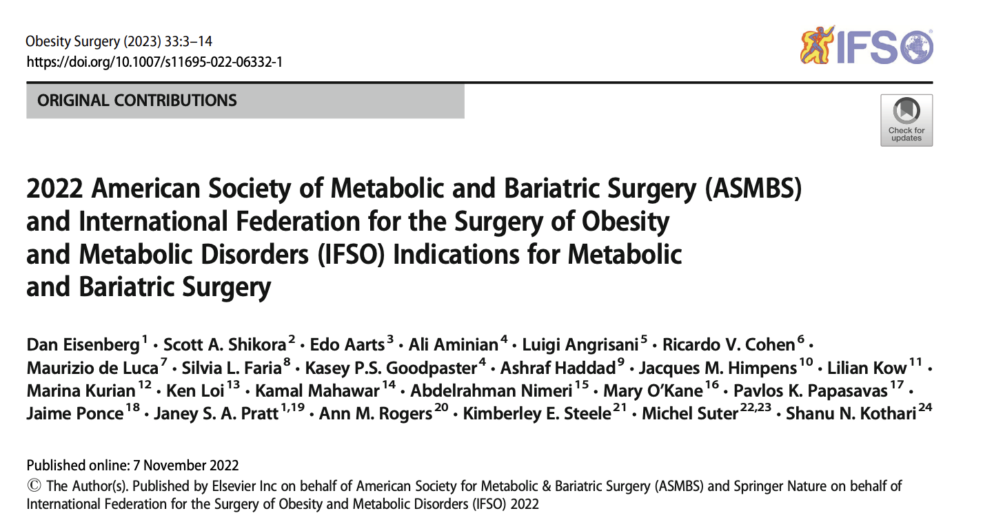
Extremes of age

Slide 13
Older population
- surgery has been performed successfully in increasingly older patients over the past few decades, including individuals >70 years of age
- slightly higher rates of postoperative complications compared with a younger population, but still provides substantial benefits of weight loss and remission of comorbilities
- Frailty, rather than age alone, is independently associated with higher rates of postoperative complications following MBS
The risk of surgery should be evaluated against the morbidity risk of obesity-related diseases.
- There is no evidence to support an age limit on patients seeking MBS, but careful selection that includes assessment of frailty is recommended.

Slide 14
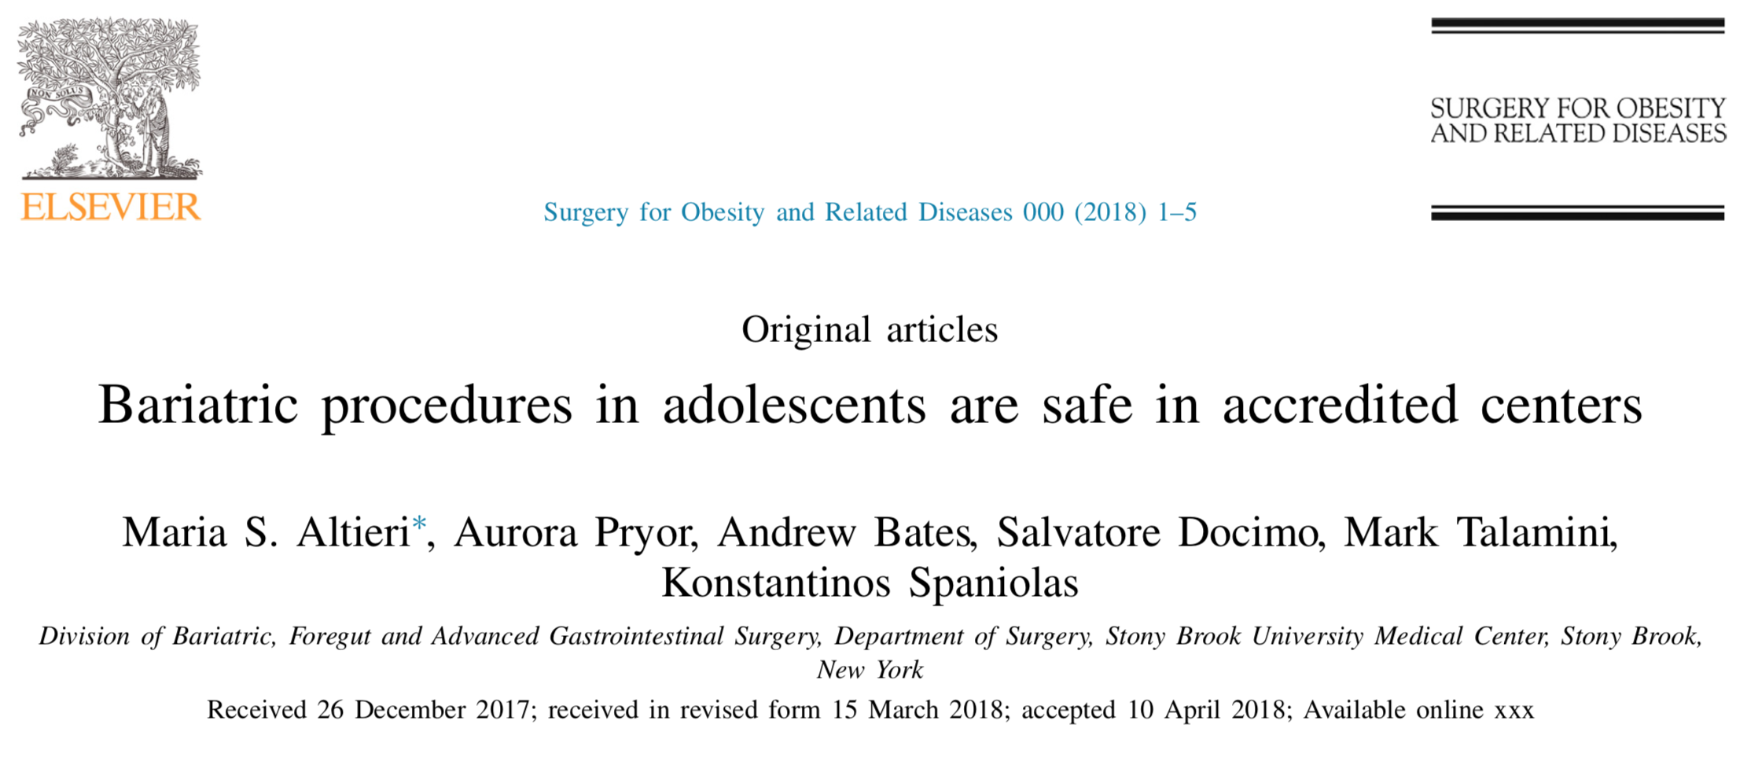
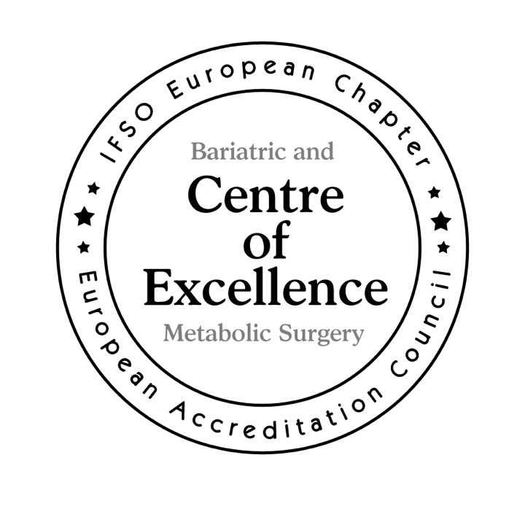
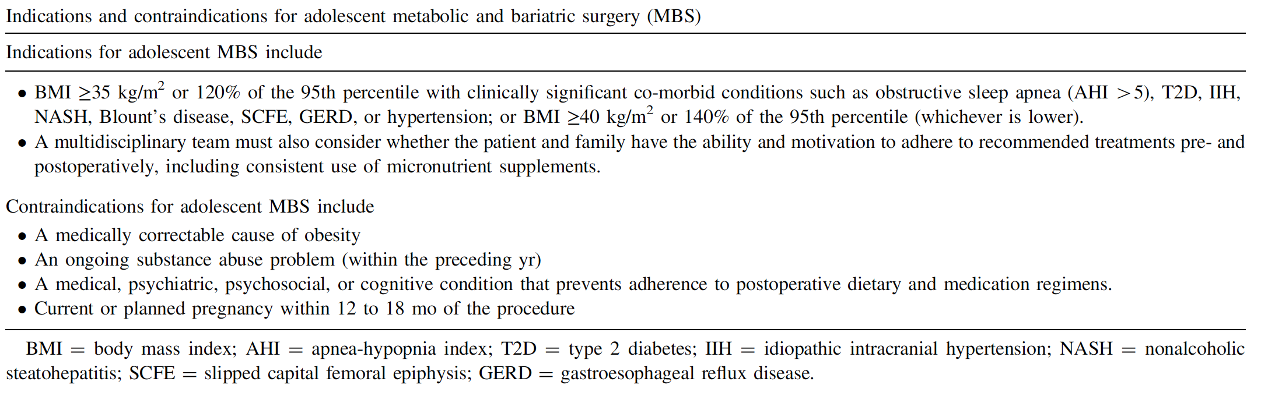
Pediatrics and adolescents
- MBS is safe in the population younger than 18 years and produces durable weight loss and improvement in comorbid conditions.
The prospective TeenLongitudinal Assessment of Bariatric Surgery database (Teen-LABS) demonstrated significant weight loss and durable improvement in cardiovascular risk factors (hypertension and dyslipidemia )and T2D in adolescents undergoing MBS.
MBS does not negatively impact pubertal development
- Durable weight loss and maintained co-morbidity remission in patients as young as 5 years old
- Children and adolescents with BMI >120% of the 95th percentile and a major co-morbidity, or a BMI >140% of the 95th percentile, should be considered for MBS after evaluation by a multidisciplinary team in a specialty center.

Slide 15


